Slide 1

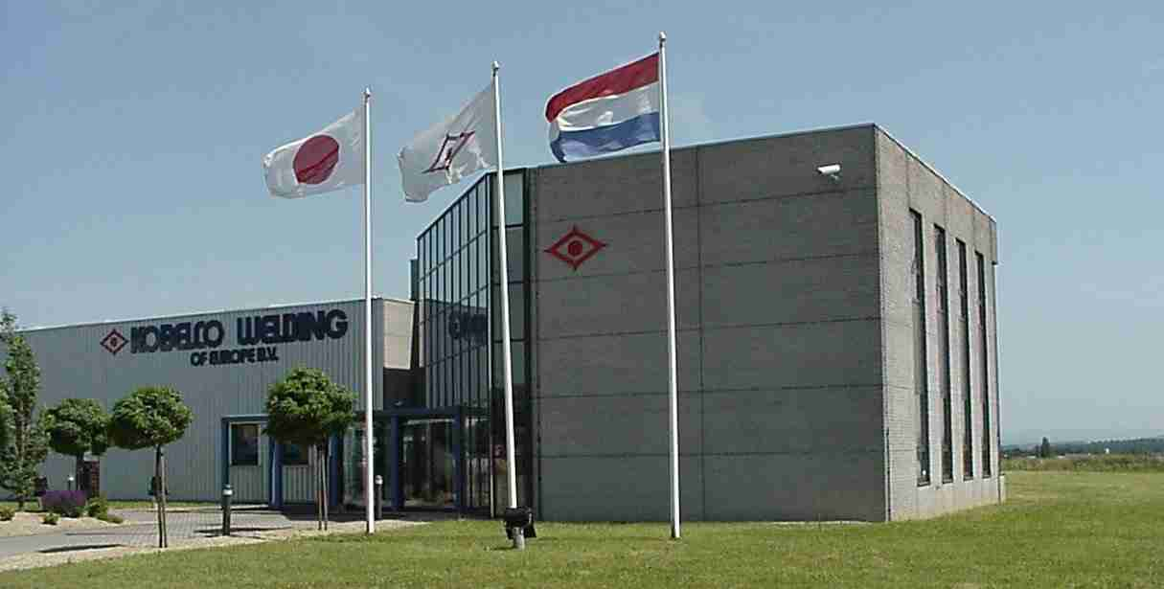


KOBELCO WELDING
OF EUROPÉ, KWE

Slide 2
KOBELCO WELDING
OF EUROPÉ, KWE
OUR VISION:
Se estabeblece Kobelco como el fabricante lider en consumibles de soldadura y proveedor en Europa, tanto en terminos de calidad, soporte y ventas.
Kobelco pasaria a ser la eleccion natural para todos los segmentos de la industria y proporcionaria un programa completo de consumibles con el fin de poder ofrecer una solucion completa en terminos de soldadura para el usuario final.

Slide 3
KOBELCO WELDING
OF EUROPÉ, KWE
Fundada como una filial de Kobelco Welding LTD.
Extendido en 2006
Manufacturas MS & SS FCW
Integracion de las operaciones de fabricacion, almacenamiento, clientes y soporte tecnico.
Notes:
Desde 1994 hasta 2006 Kobelco Welding of Europe producia SS FCW
Durante 2005 la planta fue ampliada para dar espacio a MS drawing lines, spooling and packing facilities, e incrementar la capacidad del almacen.
Capacidad mensual es 500-600MT acero, & 80-100MT acero inoxidable FCW
Desde estonces todos los materiales alta y no aleados vendidos en Europa son fabricados en KWE.
Algunos materiales especiales y de baja aleacion se siguen produciendo en la Planta Irabaki, Japon.
El material de KWE puede ser suministrado en bobinas de 5 y 15 kg, asi como 250 kg EcoPac
Both plastic and wire basket spools pueden ser suministrados
All wire basket spools can be used without an adapter, including the 5kg spools

Slide 4
Product program, KWE
Strip based FCW for MS & SS materials
Kobelco strip based products offers the ultimate characteristics for FCW:
High deposition rate = Low manufacturing costs
High current density = Low energy consumption
Non-hygroscopic flux = No moisture pick up
Stable quality = Reduced downtime
Flexible operability = Reduced initial time
Notes:
Strip based flux cored wires are globally the dominant manufacturing method due the high versatility, high productivity and high quality this method offers
All major manufacturers such as Kobelco, Esab, Lincoln, Hyundai, Kiswel, Hobart, Tien Tai are producing their wires from strip.

Slide 5
KOBELCO WELDING
OF EUROPÉ, KWE
OUR CUSTOMER COMMITMENT:

Slide 6
Quality Products - TQ
Single source, same manufacturing equipment = Same Quality World Wide
Total traceability during manufacturing
All batches tested prior to delivery
IC issued for all batches
Notes:
All flux comes pre-mixed from Ibaraki, Japan
All strip materials are checked for chemistry, and has to be approved before going into production
Minor adjustments based on the chemistry of the strip are performed in KWE
We have total traceability of the flux, strip, and manufacturing
Flux = Batch handling
Strip = Batch handling
Manufacturing = DAS, (data aqusition system)
All drawing benches has a data acquisition system that monitors all critical steps in the production process
If one value is outside the specified range, the system will stop the drawing bench
After drawing all batches are welded, and an all weld metal test are performed
IC, (inspection certificate), for the actual batch are issued based on the result from the all weld metal test

Slide 7
Q - Technical Support - Q
Material, application, solution support
Hands on support
Customer initiated development
World wide experience within all segments
From consumables to total solutions
Notes:
Based on requirements, base material, and available manufacturing equipment, our technical team can assist with proposals for welding method/methods, consumables, welding parameters, etc
We can provide hand on support for your key accounts in order to ensure that our products are used in the optimum way, in order to secure quality, productivity and health and safety
In many cases the work we do together with end users lead to improvement projects, new consumables and/or welding solutions in order to be able to fulfil the task at hand in the best possible way, technically and commercially
Our experience working together with other end users, in the same segments as you are working, will mean that you will benefit from experiences and development work done all around the globe
Solid, stick, flux & metal cored wires, welding solutions like SAW solutions including special backing systems, or totally integrated robotic applications, KOBELCO is your partner in welding!

Slide 8
QT - Quick Delivery
Material stocked in Holland
Delivery time = Transportation time
Flexible manufacturing
Integrated customer support
Well developed logistic partners
Notes:
When the plant were extended in 2006, the warehouse capacity were also enlarged, bringing the total capacity to 1.100 – 1.200MT
Typical split between SS and MS materials are 250 - 300MT SS FCW, and 700 - 900 MT MS FCW
Material for key accounts with a frame agreement will be kept in stock according to planned and agreed consumption
Most destination within Europe can be reached within one week
In cases of “emergencies” manufacturing can be “re-planned”, in order to meet the requirement
Customer support are integrated in the same organisation as manufacturing in order to shorten decision routes
We are working with logistic partners for shipment and transportation that are selected based on availability & service for individual markets

Slide 9
Kobelco’s position Globally
Japan’s number one, and one of the leading suppliers in Asia
The largest FCW plant in the world, Ibaraki
Market leader in North America and in Europe for SS FCW
Notes:
Kobe Steel's Welding Business has been Japan's top manufacturer of welding consumables for the past half century. With a global presence, the Welding Business has 10 manufacturing and sales bases in Asia, Europe and the Unites States. We're a comprehensive supplier of welding products, contributing to the welding needs of numerous industries. We manufacture welding robots, power sources and equipment, which are packaged with welding consumables into original welding systems. Backed by forward looking R&D and market development, all of our dynamic and global activities are based on QTQ, "Quality products, Technical support and Quick delivery.“
To meet this strong worldwide market, the Kobe Steel Group has been rapidly increasing its global supply capabilities. In Japan, Kobe Steel's Ibaraki Plant in Osaka has been adding capacity. Within this fiscal year (ending March 2008), it will achieve an annual production capacity of 70,000 metric tons.

Slide 10
Some of our market segments
Shipbuilding
Oil & Gas field development
Construction Equipment
Pressure Vessels
Pipelines

Slide 11
Pressure Vessels, this is what we do
Fully integrated manufacturer
Manufacturing of Cr-Mo, Cr-Mo-V steels
Manufacturer of forged shells
Engineering & Assembly
Manufacturing of all types of welding consumables for these materials
Own manufacturing unit for Reactors, Pressure Vessels, Heat Exchangers, etc.
Notes:
Kobe Steel, under an integrated management system, is the only company in the world to be self-sufficient in the supply of the main materials for pressure vessels such as forged shells, heavy steel plates and even welding materials.
With our high level of technology, developed through decades of experience in the manufacture of pressure vessels, and through the cooperation between our materials divisions including the welding division, we deliver the world's highest quality pressure vessels to oil refineries and a variety of chemical plants.
Since 1967, Kobe Steel has been manufacturing desulphurization and hydro cracking reactors and delivering them to oil refineries around the world.

Slide 12
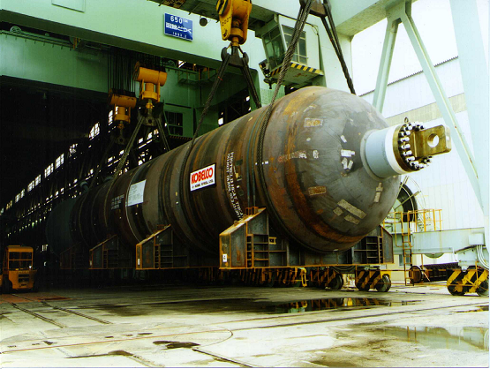
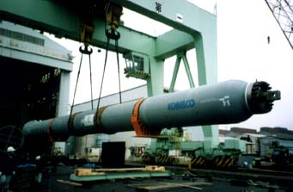
Kobe Steel, Takasago Works
Notes:
The pressure vessel manufacturing plant is located at the Takasago Works (Takasago City, Hyogo Prefecture) of Kobe Steel, and the 2,000 ton final assembly plant is located in Harima Works (Harima-cho, Hyogo Prefecture) about 10km east of Takasago Works. Takasago Works is capable of manufacturing and shipping pressure vessels up to 1,050 tons, while Harima Plant is for final assembling of super large pressure vessels exceeding 1,050 tons.
Authorized quality assurance system from ASME and others.
The quality assurance system of Kobe Steel's pressure vessel plant is authorized under the following codes: ASME U, U2, U3 TUV ISO 9001, ISO 14001 Manufacture License of Special Equipment (Pressure Vessel) People's Republic of China KGS for pressure vessel manufacture

Slide 13
Solutions for Reactors
 | 1.25Cr-0.5Mo | 2.25Cr-1Mo | 2.25Cr-1Mo-V
SMAW | (AC) CM-A96MB (DC) CM-A96MBD | (AC) CM-A106N (DC) CM-A106ND | (AC) CM-A106H (DC) CM-A106HD
GTAW | TG-S1CM | TG-S2CM | TG-S2CMH
GMAW | MG-S1CM | MG-S2CM
FCAW | DW-81B2 | DW-91B3
SAW | (AC) US-511N/PF-200 (DC) US-511ND/PF-200D | (AC) US-521S/PF-200 (DC) US-521S/PF-200D | (AC) US-521H/PF-500 (DC) US-521HD/PF-500D

Slide 14
Example of Cr-Mo-V documentation
Typical chemical composition of weld metal
Typical temper embrittlement properties
C | 0.09 | Sb | 0.002
Si | 0.15 | Sn | 0.001
Mn | 1.08 | As | 0.004
P | 0.004 | Si+Mn | 1.23
S | 0.002 | X-bar | 6
Cu | 0.10 | J-Factor | 62
Ni | 0.02
Cr | 2.46
Mo | 1.10
V | 0.35
Nb | 0.014
vTr55 | vTr’55 | △vTr55 | vTr55+3△vTr55
-48 (C) | -51 (C) | 0 (C) | -48 (C)

Slide 15
Solutions for cladding
Electro slag, Sub Arc & Flux cored wire
Main grades
309L & 309LNb
308L & 347
309MoL & 316L
82 & 625

Slide 16
Some Highlights
DW-309LNb for improved chemistry for cladding applications.
DW-N625, all positional Alloy 625 FCW. Also improved for cladding applications. (Less dilution)

Slide 17
Summary
By offering top of the line products, supported by technical expertise and know-how & continues R&D, we believe we will be an interesting partner to the demanding industry, now and in the future.

Slide 18
The End
Thanks for listening to this short introduction to KWE, and some examples of Kobelco’s position in Pressure Vessels globally.
Any questions?

